Slide 1


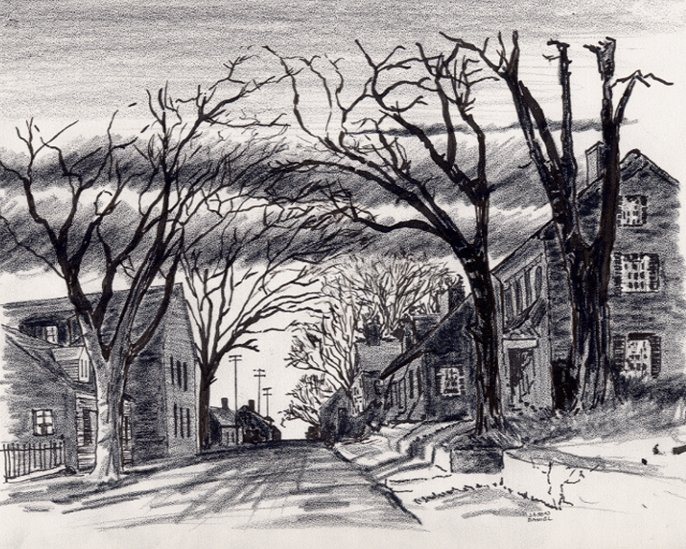

9. My Organization “Support Plan” for the To the Uttermost Parts of the World Bible Distribution App
12-1-2024
Everyone
Everywhere
Any Device
Dallas CLOUD
Cell Phone
Notebook
Laptop
Desktop
National Movement Ministries; Grace Technology Not for Profit; Missions & Small Churches Cloud Management, Finance and IT Infrastructure; UsSowinfgSeed.org and B4EE (Bibles 4 Everyone Everywhere; Cloud4Christ.org Missions & Churches Inside and Outside the Walls Ministries and Outreach, Acts 1-8 Worldwide; Cloud4Christ.org Toolbox Development and Information Technology Support; and World -Wide Support Ministries.
1

Slide 2
9. My Church “Plan and Support” for the Whole World Bible Distribution Web Store App
Background:
This program, along with our ten other similar Church Bible Legacy Cloud Programs with corresponding Apps have their origins in the fact that Winona, my wife, loved and taught children in public, private and religious organizations for 70 years.
Winona and her husband always had an overwhelming desire to get the word out, particularly to children.
World–Wide Organization workers, of course, know that each Country requires special plans and considerations. Workers also know not to expect everyone to automatically venture into the walls of a brick-and-mortar Mission or Church.
This program is also based on the belief that each Christian should fulfill Jesus’ command that they should go into the whole World and meet the World’s needs and encourage all to accept Jesus as their Savior and Lord. Even new Christians should serve in the Church, and of course, follow Jesus’ Command to “Get the word out” to the whole World.
2

Slide 3
9. “My Church Plan and Support” for the Whole World Bible Distribution Web App
Purpose:
The purpose of this instruction for “My Church Plan and Support” for the Whole World Bible Distribution Web Apps UsSowingSeed.org and B4EE.org, Bibles Everyone Everywhere is to encourage every Church Member to actively engage in all phases of World ministry and outreach even if it is limited to Bible distribution or monetary support.
Becoming an organization or an individual who knows the needs of many or all Families of the entire World would be beneficial also.
Our prayer is that all will come to put their faith and trust in Jesus, the True Creator of the Universe, and become Servants of God through a World-Wide Ministry.
3

Slide 4
9. “My Church Plan and Support” for the Whole World Bible Distribution Web App
Scope
The scope of this “My Church Plan and Support” for the Whole World Bible Distribution Web Apps, UsSowingSeed.org and B4EE,org, are to provide Bibles to everyone, everywhere.
The above Apps also provides the computer functions to obtain, distribute and record Bible distributions.
Existing Christian Organizations, Missions, Churches and individuals are suited for this Project.
4

Slide 5
9. “My Church Plan and Support” for the Whole World Bible Distribution Web Store App
The Program is important because:
There is not enough time to allow using just old methods and organizations. A new state-of-the-art Cloud Platform with its ~29 Apps must be quickly finished and used now. The Church Planting Movement must also continue and be well planned and implemented. The use of these tools was made possible in late 2024 via www.Cloud4Christ.org Platform, using Apps such as UsSowingSeed.org and B4EE.org The UsSowingSeed.org is available now to deliver Zonderkidz Children’s Picture Bibles. We need to effectively use more laborers, social media, and the Cloud4Christ.org.
2. God has been at work over 2000 Years getting Individuals, Groups and Organizations ready our now existing End-time push. I believe the older generation will mainly provide required guidance, but I believe the Youth; College and University Students, and the Younger Adults must do the heavy lifting.
3. God has purposed each of us and has called and has placed each of us in our roles.
This new technology is needed now to instantaneously allow immediate, collaborative, and complete integration and proof of Great Commission completion. Log onto Cloud4Christ.org, B4EE.org, and UsSowingSeed.org and sign-up to perform your work on these Web tools.
God will be glorified when we use all means to fill his Universal Church, with those believers Jesus has and will grant new life for Eternity.
5

Slide 6
9. “My Church Plan and Support” for the Whole World Bible Distribution Web Store App
Nine Universal Elements for Individuals, Missions and Churches :
1. Extraordinary Prayer (Essential to have a dedicated Prayer Team)
2. Abundant Evangelism such as “Choose Your One”
Intentional Priorities given to Grace Technology administered ~29 Cloud4Christ.org Platform Web Apps
Authority of God’s Word
Identify and Disciple All Church Members and send them out.
6

Slide 7
9. My Church “Plan and Support” for the Whole World Bible Distribution Web Store App
Ten Universal Elements for Individuals, Missions and Churches - Continued:
6. Place Each Organization Member in Position (s) based on their Gifts, Training and Interests
7. Train All Organization Members for Great Commission Work in their selected Section of the World
8. Saturate your Great Commission Work through Ministry, Fellowship and Evangelism
Assimilate Community People into Church Membership & Ministry - Within the Walls and Outside The Walls of Missions and Churches
10. Giving.
7

Slide 8
9. My Church “Plan and Support” for the Whole World Bible Distribution Web Store App
Organization Needs
1. Organization Program Administrator
2. Specific World Outreach Organizations such as a Mission, Church, Association, Convention, National Board, or World Organization to manage different Mission opportunities.
8

Slide 9
9. My Church “Plan and Support” for the Whole World Bible Distribution Web Store App
Age Graded Bible Distribution
a. Deliver a Zonderkidz© Children’s Picture Bible using UsSowingSeed.org ,
b. Deliver other age-graded Bibles to each residence (Single Dwellimg, Duplex, Apt. using the B4EE.org App
c. Maintain a prayer list, pray, and bring any special needs to your designated Prayer Team.
9

Slide 10
9. My Church “Plan and Support” for the Whole World Bible Distribution Web Store App
Here is the Bottom line on how to perform this Cloud4Christ.org Web App no matter how you may find out how to get started.
1. Log onto Cloud4Christ.org, choose Software and Apps Icon
2. Register your Organization Administrator, or have the designated one log-in.
3. Assign an App Administrator for this Project
4. Assign work packages to eager Organizations or workers. Determine needed training and train.
5. Record work performed in appropriate apps such as UsSowinSeed.org and B4EE.org.
10

Slide 11
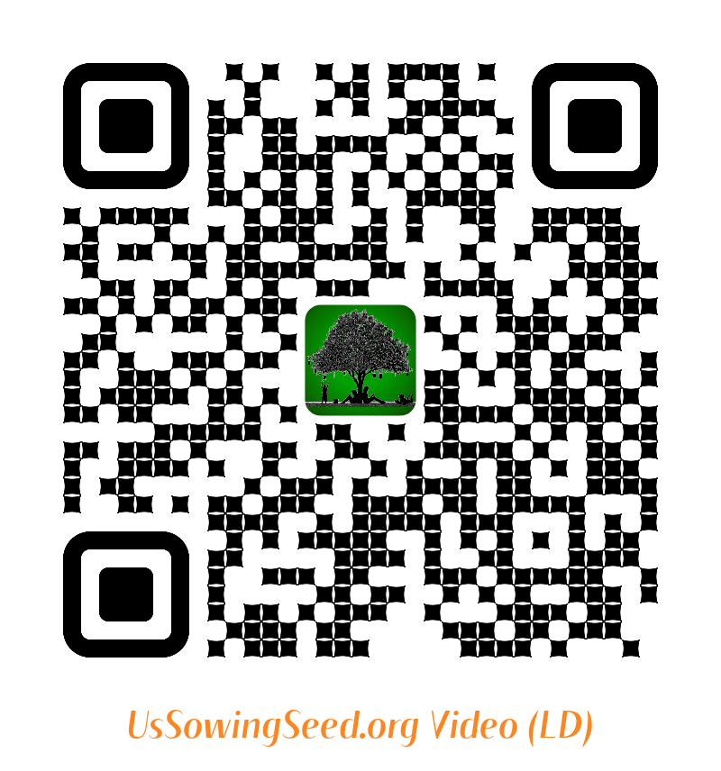
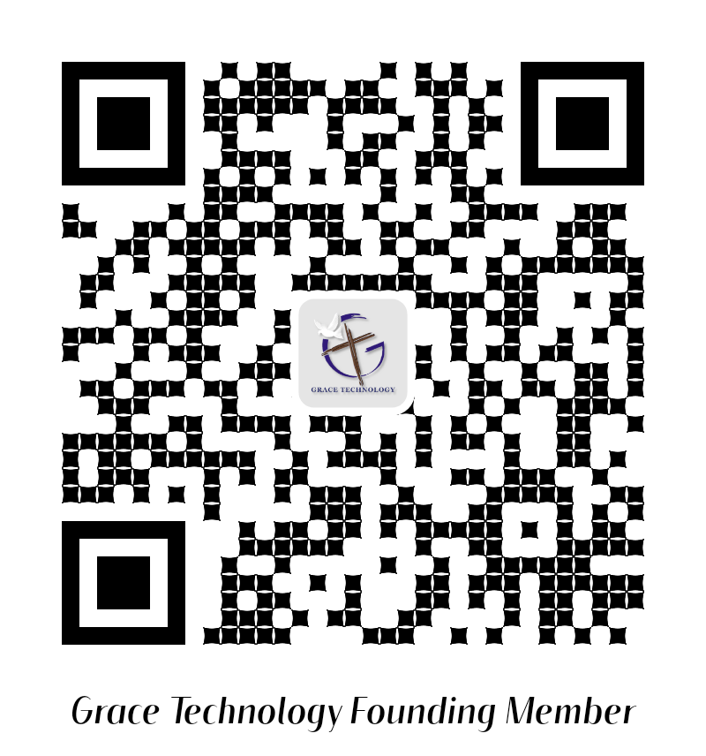
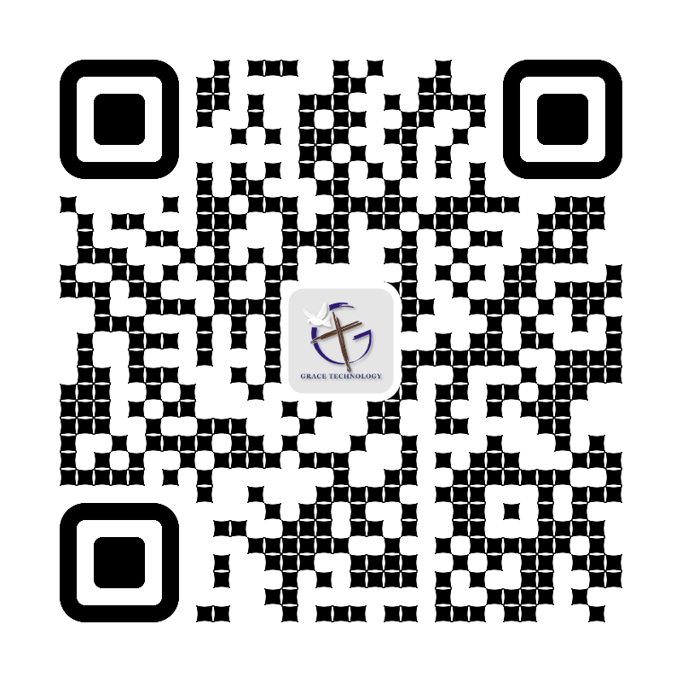
9. My Church “Plan and Support” for the Whole World Bible Distribution Web Store App
Use the following QR codes to view the Bible Video, or to Donate.
Video
Video
Become a Cloud4Christ Founder,
and be one of a 1000 $10.00/Month
Contributors.
Donate
General
Use the above QR codes to “Donate to the Non-profit Grace Technology Organization, as a tax-deductible contribution. Note: you may use a Debit Card, Credit Card, Pay Pal, etc.
11

