Slide 1


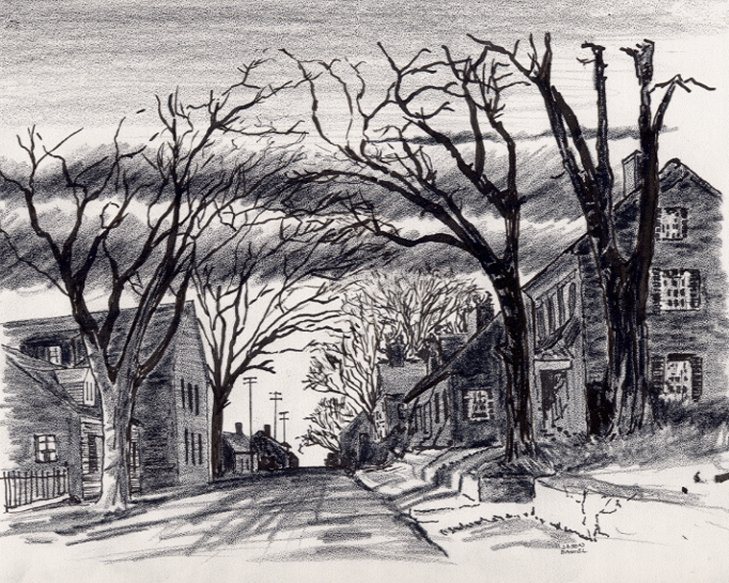

7. My Organization “Samaria” Area (State Collective Regions) Outreach Program App
4-8-24
Everyone
Everyplace
Everywhere
Any Device
Dallas CLOUD
Cell Phone
Notebook
Laptop
Desktop
Cloud4Christ Church Inside and Outside the Walls Ministries; National Movement Ministries; World -Wide Support Ministries; Cloud4Christ.org Tools Development and Information Technology Support; Missions & Small Church Cloud Management and IT Infrastructure; and Bee Ministries
1

Slide 2
7. My Organization “Samaria” Area (State Collective Regions) Outreach Program App
Background:
This program, along with our ten other similar Church Bible Legacy Cloud Apps have their origins in the fact that Winona, my wife, loved and taught children in public, private and religious organizations for 70 years.
Winona and her husband always had an overwhelming desire to get the word out, particularly to children.
Churches, Associations, State Regions and Volunteer Christian Groups should also not expect everyone to automatically come to their brick-and-mortar Churches. Acts 1:8 says go! This, Samaria, is the third of four places to go and spread the Good News.
It is also based on the belief that each Christian should fulfill Jesus’ command that they should go into the whole World, starting at “Jerusalem”, Then to “Judea”, “Samaria”, and the “Uttermost Parts of the World”. All community and Family needs should be met. Matthew 28:19-20 provides us our command, including encouraging each and all individuals to accept Jesus as their Savior and Lord. The new Christians should serve in the Church, and of course, follow Jesus’ Command to “Get the word out”.
Although this App is normally performed by a State Convention, Churches or a Non-Church Christian Group of very dedicated Christians may band together and help perform the App for a State Region. The Cloud4Christ, UsSowingSeed.org App, “My Street” distribution method will be used.
2

Slide 3
7. My Organization “Samaria” Area (State) Outreach Program App
Purpose:
The purpose of this “Samaria” (State Region) 0utreach App is to deliver 3 to 4 age graded Bibles to each residence in the Church’s selected “Samaruia” area, during the next few months. It is our prayer that current Generation Families (Parents, Sons and Daughters) as Street Captains, will respond in a Spirit filled way. This appears to have partially happened at 4 Colleges/Universities in 2023-2024.
It is planned that personal relationships as appropriate be established, needs be discovered and met, prayers be offered, and witnessing be conducted. By these activities, many will come to put their faith and trust in Jesus, the true Creator of the universe. Who is your One?
Note: App conduct by Non-Church Christian groups may be limited to delivery of a Zonderkitz © Children’s Picture Bible.
3

Slide 4
7. My Organization “Samaria” Area (State) Outreach Program App
Scope
The scope of this “Samaria” outreach program Outside the Church walls may include:
1. Preparing a wall Map or a streaming TV highlighting all County streets, noting Streets that are not included in any Church “Jerusalem” or “Judea” area.
2. Using the Cloud4Christ.org database Platform for each residence family
3. Recruiting co-laborers from Association, Churches, community, etc. to act as team members
4. Defining, prioritizing, scheduling and performing activities such as all types of outreach and benevolence contacts and activities
5. Praying; Visiting; Witnessing; Conducting Block Parties; Presenting Training Classes; Making Phone Calls, Sending E-Mails, Maintaining Social Media, etc.
6. Coordinating with the Association and its Churches.
4

Slide 5
7. My Organization “Samaria” Area (State) Outreach Program App
The Program is important because:
There is not enough time to allow using just old methods and organizations. A new state-of-the-art Cloud Platform with an App must be quickly finished and used now. The Church Planting Movement must also continue and be well planned and implemented. The use of these tools will be possible in early 2024 via www.Cloud4Christ.org Platform. Web Apps, (such as, UsSowingSeedSamaria.org “My Street” distribution method). We need to effectively use more laborers, and social media also.
2. God has been at work over 2000 Years getting Individuals, Groups and Organizations ready for a possible End-time push. I believe the older generation may mainly provide required guidance, but I believe the Current Families of Adults; Youth; College and University Students must do the heavy lifting.
3. God has purposed each of us; and has called and has placed each of us in our roles.
This new technology is needed now to instantaneously allow immediate, collaborative, and complete integration and proof of Great Commission completion. Please Log onto UsSowingSee.org) and sign-up to perform this work in your State Region.
God will be glorified when we use all means to fill his Universal Church, with those believers Jesus has and will grant new life for Eternity.
5

Slide 6
7. My Organization “Samaria” Area (State) Outreach Program App
Eleven Universal Elements for Churches/Missions:
1. Extraordinary Prayer (Essential to have a dedicated Prayer Team)
2. Abundant Evangelism such as “Choose Your One”
Intentional Priorities given to Cloud4Christ.org Ministies and Grace Technology administered 59 Cloud4Christ.org Platform Web Apps
Authority of God’s Word
Identify and Disciple All Church Members
Note: Only Items 1. and 4. apply to Non-Church Christian groups.
6

Slide 7
7. My Organization “Samaria” Area (State) Outreach Program App
Nine Universal Elements for Churches/Missions - Continued:
6. Place Each Church Member in Position (s) based on their Gifts, Training and Interests
7. Train All Church Members for Great Commission Work in their “Samaria” Area, and Beyond
8. Saturate your “Samaria” Area through Ministry, Fellowship and Evangelism
Assimilate Community People into Church Membership & Ministry - Within the Walls and Outside The Walls of the Church
Monthly Church Community Advertisement Communications
Giving.
Note: None of the above applies to Non-Church Christian groups.
7

Slide 8
7. My Organization “Samaria” Area (State) Outreach Program App
Organization Needs
1. Program Leader – Select an Assistant, and Manage this Activity within the “Samaria Area”
2. Program Leader Assistant
a. Stand in for the Program Leader as requested.
b. Perform duties assigned by the Program Leader, and those duties recognized as needing to be performed.
8

Slide 9
7. My Organization “Samaria” Area (State) Outreach Program App
2. “County Street Ministry Assignees”:
a. Deliver a Zonderkitz (c) Children’s Picture Bible along with 3 to 4 other age graded Bibles to each residence in the Church’s selected “Samaria Region” area, during the next few months. All Bibles will be delivered using the UsSowingSeed.org Web “My Street” distribution method.
b. Maintain a prayer list and actively pray for them. Take special needs to the church commissioned Prayer Teams.
c. Perform other Ministry functions such as:
1. Meeting benevolence needs
2. Witnessing
3. Community Outreach and Entertaining Events
Note: Non-Church Christian groups need to only deliver the Children’s Bible only.
9

Slide 10
7. My Organization “Samaria” Area (State) Outreach Program App
c. Perform other Ministry functions such as - Continued:
3. Deliver promotional materials, such as door hangers
4. Sponsor Home Get-togethers, Street parties, etc.
5. Lawn care
6. Other.
Note: None of the above items apply to Non-Church Christian Groups.
10

Slide 11
7. My Organization “Samaria” Area (State) Outreach Program App
Here is the Bottom line on how to perform this Cloud4Christ.org Web App.
1. Select your “Judea” County where Bibles are to be delivered
2. Select Leaders and Laborers
3. Log onto the UsSowingSeed.org when available. May initiate App using the QR code at right, when available
4. Obtain Bibles and deliver to each Street residence, as money becomes available. Note: Only Zonderkitz © Children’s Picture Bibles need to be delivered by Non-Church Christian groups.
5. Obtain Bibles from available local sources or use the above QR code App and Select “Get Bibles” to purchase Bibles.
6. Record each residence Street # where one or more Bibles were delivered. Provisions for Undeliverable Bibles will also be noted due to vacancy, a person’s decision not to accept the Word, etc. Other data may also be added as software is upgraded
11

Slide 12
7. My Organization “Samaria” Area (State) Outreach Program App
7. periodically meet with your team to review your Up-To-Date list of possible tasks, prioritize the tasks, schedule each task and perform them in a timely manner.
8. You as the App Leader, and Assistant Leader will need to coordinate with the sponsoring State Convention and participating Church leaders to stay connected and keep them informed of current status.
12

Slide 13
7. My Organization “Samaria” Area (State) Outreach Program App
RECOGNITION
After each worker has completed an initial year of service, the State should recognize them as a “5-Star “My Organization “Jerusalem” Street Minister. This may include recognition in a selected service.
In addition, the awarding of a Certificate of Appreciation or a Plaque would be good.
Note: Church and Non-Church Christian groups may or may not do their own recognition program for their group.
13

Slide 14
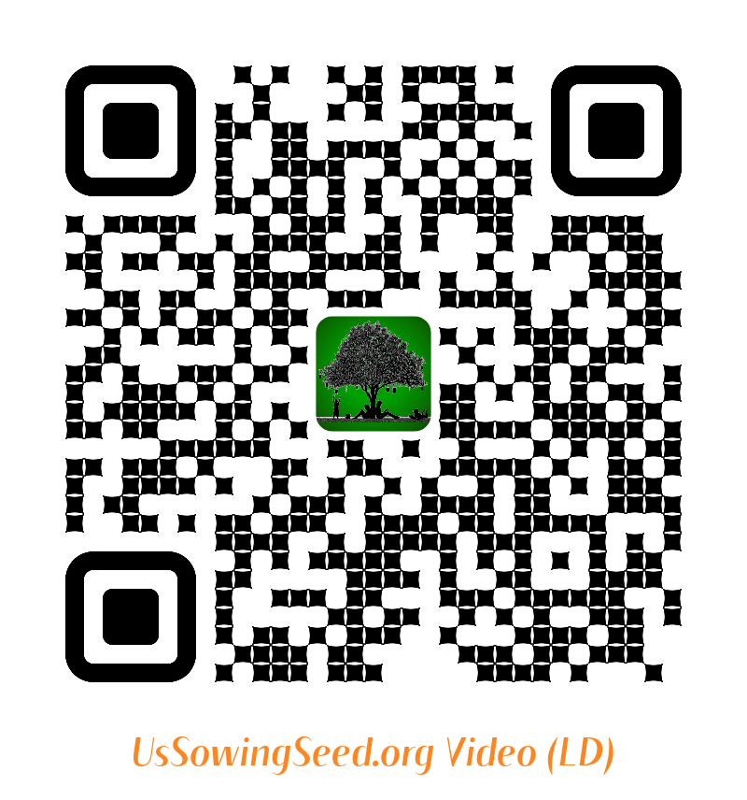
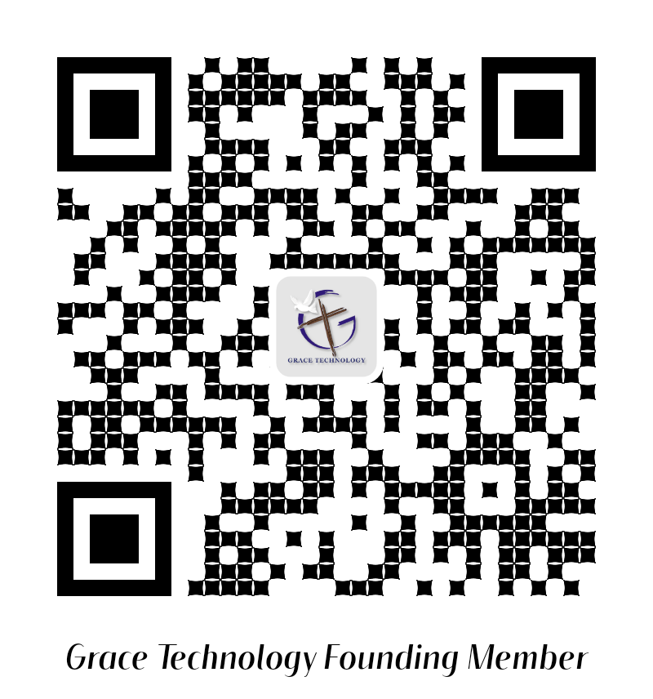
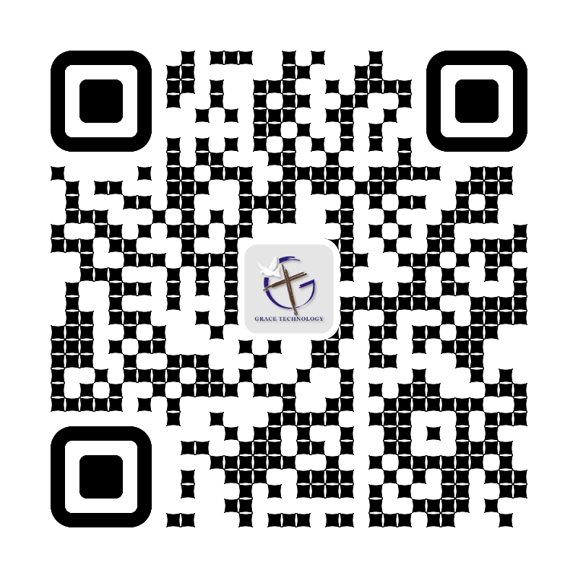
7. My Organization “Samaria” Area (State) Outreach Program App
Use the following QR codes to view the Bible Video, or to Donate.
Video
Video
Become a Cloud4Christ Founder,
and be one of a 1000 $10.00/Month
Contributors.
Donate
General
Use the above QR codes to “Donate to the Non-profit Grace Technology Organization, as a tax-deductible contribution. Note: you may use a Debit Card, Credit Card, Pay Pal, etc.
13

