Slide 1


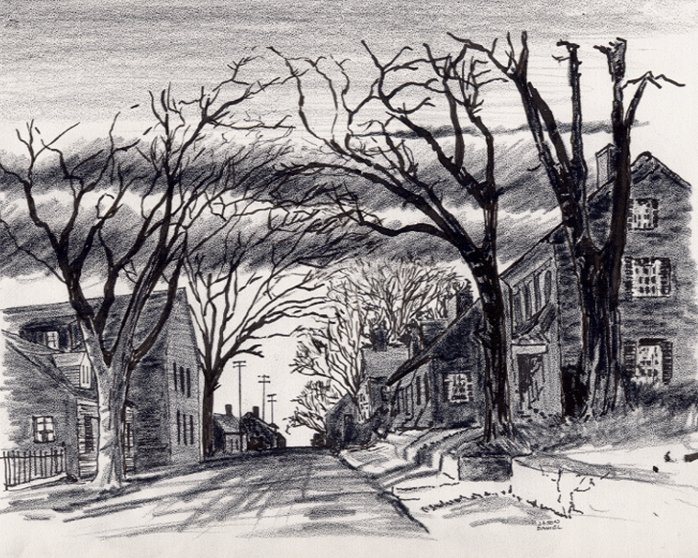

7. My Organization “Samaria” Area (State Regions) Outreach Program.ppt
4-8-24
Everyone
Everyplace
Everywhere
Any Device
Dallas CLOUD
Cell Phone
Notebook
Laptop
Desktop
Cloud4Christ Church Inside and Outside the Walls Ministries; National Movement Ministries; World -Wide Support Ministries; Cloud4Christ.org Tools Development and Information Technology Support; Missions & Small Church Cloud Management and IT Infrastructure; and Bee Ministries
1

Slide 2
7. My Organization “Samaria” Area (State Regions) Outreach Program.ppt
Background:
This program, along with our ten other similar Church Bible Legacy Cloud Apps have their origins in the fact that Winona, my wife, loved and taught children in public, private and religious organizations for 70 years.
Winona and her husband always had an overwhelming desire to get the word out, particularly to children.
Churches, Associations, State Regions, States and Volunteer Christian Groups should also not expect everyone to automatically come to their brick-and-mortar Churches. Acts 1:8 says go! This, “Samaria”, is the third of four places to go and spread the Good News.
It is also based on the belief that each Christian should fulfill Jesus’ command that they should go into the whole World, starting at “Jerusalem”, Then to “Judea”, “Samaria”, and the “Uttermost Parts of the World”. All community and Family needs should be met. Matthew 28:19-20 provides us our command, including encouraging each and all individuals to accept Jesus as their Savior and Lord. The new Christians should serve in the Church, and of course, follow Jesus’ Command to “Get the word out”.
Although this App is normally performed by a State Convention, by both State Regions and State, Churches or a Non-Church Christian Group of very dedicated Christians may band together and help. The Cloud4Christ, UsSowingSeed.org App, should be used.
2

Slide 3
7. My Organization “Samaria” Area (State Regions) Outreach Program.ppt
Purpose:
The purpose of this “Samaria” (State Regions and each State) 0utreach App is to deliver 3 to 4 age graded Bibles to each residence in the Church’s selected “Samaria” area, during the next few months. It is our prayer that current Generation Families (Parents, Sons and Daughters) as Street Captains, will respond in a Spirit filled way. This appears to have partially happened at 4 Colleges/Universities in 2023-2024.
It is planned that personal relationships as appropriate be established, needs be discovered and met, prayers be offered, and witnessing be conducted. By these activities, many will come to put their faith and trust in Jesus, the true Creator of the universe. Who is your One?
3

Slide 4
7. My Organization “Samaria” Area (State Regions) Outreach Program.ppt
Scope
The scope of this “Samaria” outreach program Outside the Church walls may include:
1. Preparing a wall Map or a streaming TV highlighting all State Region streets, noting Streets that have not been included in any Church “Jerusalem” or “Judea” area.
2. Using the Cloud4Christ.org database Platform for residence familiers
3. Recruiting co-laborers from Associations, Churches, Community, etc. to act as team members
4. Defining, prioritizing, scheduling and performing Bible activities
5. Praying; Visiting; Witnessing; Presenting Training Classes; , etc.
6. Coordinating with the Associations and its Churches.
4

Slide 5
7. My Organization “Samaria” Area (State Regions) Outreach Program.ppt
The Program is important because:
There is not enough time to allow using just old methods and organizations. A new state-of-the-art Cloud Platform with App’s must be quickly finished and used now. The Church Planting Movement must also continue and be well planned and implemented. The use of these tools will be possible in early 2024 via www.Cloud4Christ.org Platform. Web Apps, (such as, UsSowingSeed.org . We need to effectively use more laborers, and social media also.
2. God has been at work over 2000 Years getting Individuals, Groups and Organizations ready for a possible End-time push. I believe the older generation may mainly provide required guidance, but I believe the Current Families of Adults; Youth; College and University Students must do the heavy lifting.
3. God has purposed each of us; and has called and has placed each of us in our roles.
This new technology is needed now to instantaneously allow immediate, collaborative, and complete integration and proof of Great Commission completion. Please Log onto www.UsSowingSee.org and sign-up to perform this work in your State Region.
God will be glorified when we use all means to fill his Universal Church, with those believers Jesus has and will grant new life for Eternity.
5

Slide 6
7. My Organization “Samaria” Area (State Regions) Outreach Program.ppt
Eleven Universal Elements for Churches/Missions:
1. Extraordinary Prayer (Essential to have a dedicated Prayer Team)
2. Abundant Evangelism such as “Choose Your One”
Intentional Priorities given to Cloud4Christ.org Ministries and Grace Technology administered 59 Cloud4Christ.org Platform Web Apps
Authority of God’s Word
6

Slide 7
7. My Organization “Samaria” Area (State Regions) Outreach Program.ppt
Nine Universal Elements for Churches/Missions - Continued:
5. Place Each Church Member in Position (s) based on their Gifts, Training and Interests
6. Train Personnel for Great Commission Work in your “Samaria” Area, and Beyond
7

Slide 8
7. My Organization “Samaria” Area (State Regions) Outreach Program.ppt
Organization Needs
1. Program Leaders – Select an Assistant, and Manage these Activities within the “Samaria Regions and State Area”
2. Program Leader Assistant
a. Stand in for the Program Leader as requested.
b. Perform duties assigned by the Program Leader, and those duties recognized as needing to be performed.
8

Slide 9
7. My Organization “Samaria” Area (State Regions) Outreach Program.ppt
2. “Samaria” Ministry Assignees:
a. Deliver a Zonderkitz (c) Children’s Picture Bible, or equivalent along with 3 to 4 other age graded Bibles to each residence in the Church’s selected “Samaria” Regions and State area, during the next few months. All Bibles will be delivered using the UsSowingSeed.org Web distribution method.
b. Maintain a prayer list and actively pray for them. Take special needs to your commissioned Prayer Teams.
c. Perform other Ministry functions such as:
1. Meeting benevolence needs
2. Witnessing
9

Slide 10
7. My Organization “Samaria” Area (State Regions) Outreach Program.ppt
d. etc.
10

Slide 11
7. My Organization “Samaria” Area (State Regions) Outreach Program.ppt
Here is the Bottom line on how to perform this Cloud4Christ.org Web App.
1. Select your “Samaria” Region (i.e. NE Texas) where Bibles are to be delivered
2. Select Leaders and recruit a Street Captain for each street for needed Bible deliveries, from Regional Church members, etc.
3. Log onto the www.UsSowingSeed.org App. When you first start the App, you will sign in, and then log-in. Then you may select Freelance (Address by address), or “My Street” (Claim all residences on your street). As you enter each address you will add to your list to order Bibles and to deliver them. A yellow map pen will be displayed).
If you chose Freelance, a prompt to order and record Bible inventory will appear, if you have not done so earlier. Add address by address and record deliveries.
11

Slide 12
7. My Organization “Samaria” Area (State Regions & State) Outreach Program.ppt
4. periodically meet with your team to review your Up-To-Date list of possible tasks, prioritize the tasks, schedule each task and perform them in a timely manner.
8. You as the App Leader, and Assistant Leader will need to coordinate with the sponsoring State Convention and participating Church Leaders to stay connected and keep them informed of status.
12

Slide 13
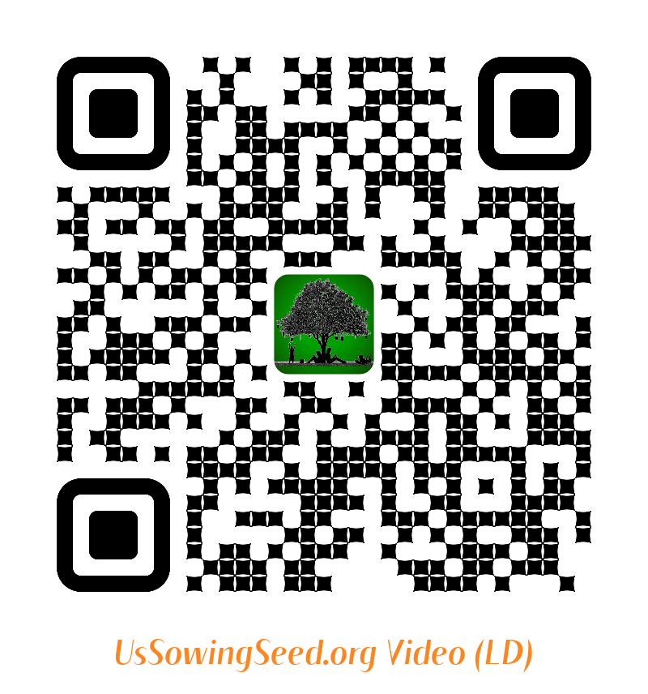
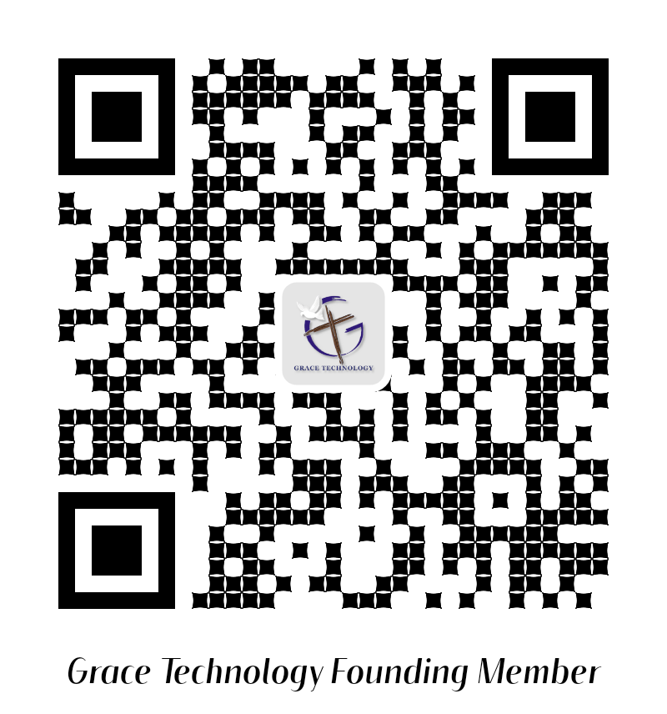
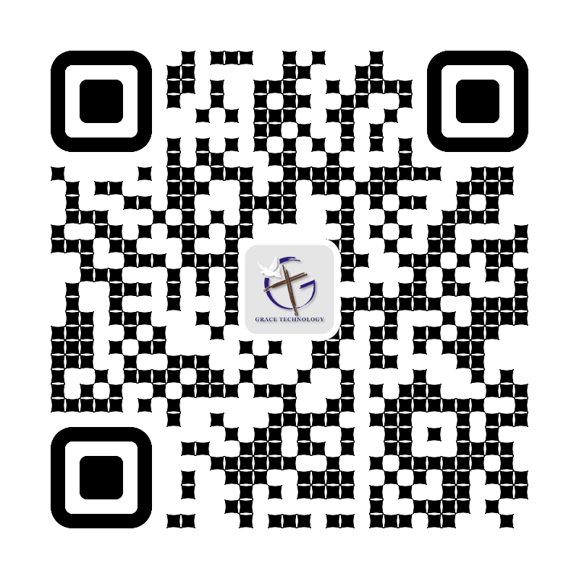
7. My Organization “Samaria” Area (State Regions & State) Outreach Program.ppt
Use the following QR codes to view the Bible Video, or to Donate.
Video
Video
Become a Cloud4Christ Founder,
and be one of a 1000 $10.00/Month
Contributors.
Donate
General
Use the above QR codes to “Donate to the Non-profit Grace Technology Organization, as a tax-deductible contribution. Note: you may use a Debit Card, Credit Card, Pay Pal, etc.
14

