Slide 1

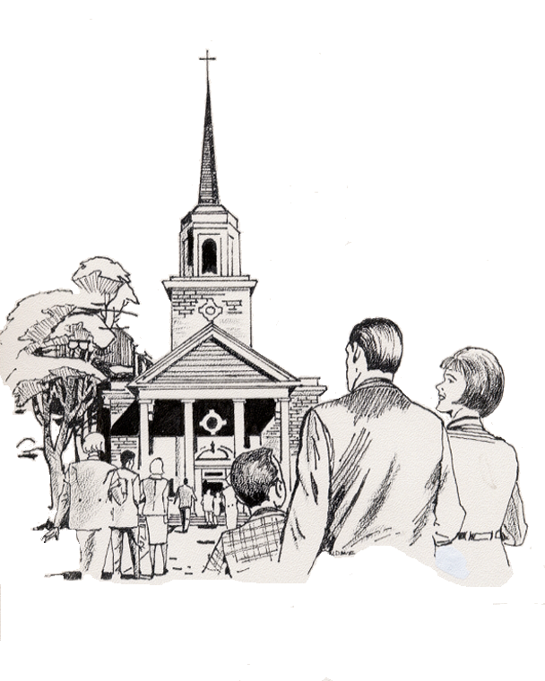
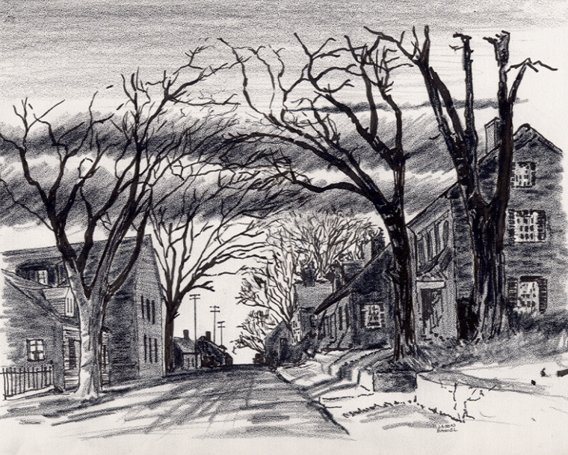

5. “My “Jerusalem” Street by Street Community Ministry & Outreach” - Outside the Church Walls Web App ©
8-26-24
Everyone
Everyplace
Everywhere
Any Device
Dallas CLOUD
Cell Phone
Notebook
Laptop
Desktop
Cloud4Christ Church Inside and Outside the Walls Ministries; National Movement Ministries; World -Wide Support Ministries; Cloud4Christ.org Tools Development and Information Technology Support; Missions & Small Church Cloud Management and IT Infrastructure; and B4EE (Bibles 4 Everyone Everywhere Ministries
1

Slide 2
5. “My “Jerusalem” Street by Street Community Ministry & Outreach” - Outside the Church Walls Web App ©
Background:
This program, along with our other related Cloud4Christ Web Apps, have their origins in the fact that Winona, my wife, loved and taught children in public, private and religious organizations for 70 years. American Bible Society has published her legacy, and it is recorded on their Face Book and Web Site.
Winona and her husband always had an overwhelming desire to advance the Great Commission by many ways; such as getting the word out, particularly to children.
It is also based on the belief that every Church Member should participate in fulfilling the Vision to deliver at least one Zonderkitz © Children’s Picture Bible to every residence, starting in “Jerusalem” and continuing through the Uttermost Parts of the World”. Every opportunity will also be taken to encourage everyone everywhere to accept Jesus as their Savior and Lord. Of course, every new Christian should be trained and serve faithfully.
“Jerusalem” Radius Area Ministry is normally performed by Missions and Churches.
2

Slide 3
5. “My “Jerusalem” Street by Street Community Ministry & Outreach” - Outside the Church Walls Web App ©
Purpose:
The first purpose of this App is to deliver a Zonderkitz © Children’s Picture Bible to each residence in the U.S.A., during the next three years. The UsSowingSeed.org Web App will be used. It is our prayer that current Generation Sons and Daughters will respond in a Spirit filled way.
Our prayer is also that older Children, Parents and Grandparents will help the younger children by reading and discussing the stories with them. By this activity, many will come to put their faith and trust in Jesus, the true Creator and Sustainer of the Universe.
A second purpose is to deliver 3-4 other types of Bibles to each “Jerusalem” residence in 3 months. Our B4EE Web App will be available soon and used for this purpose. This presentation how-to resource Power Point will direct the task of selecting Leaders and Street Stewarts to deliver the Bibles, as well as other Ministry and Outreach activities.
3

Slide 4
5. “My Jerusalem Street by Street Community Ministry & Outreach” - Outside the Church Walls App ©
Scope
The scope of this “Jerusalem” Radius Area Ministry and Otreach program Outside the Church walls includes:
1. Preparing a Large Wall Map, and/or a Streaming TV, highlighting the streets that are included in the Church’s “Jerusalem” Radius Area
2. Maintaining an OTCWJRA.org (Outside the Church Walls “Jerusalem” Radius Area.org) Web App, for How-To Power Point Instructions that encompass every Street and Residence. Various contacts and events will be made and recorded in this Web App Information and Database
3. Meeting various Family needs
4. Performing functions such as Prayer, Visits, Witnessing, Block Parties, Phone Calls, and E-Mails
5. Coordinating with your Church leaders and other appropriate individuals and groups within the Church.
4

Slide 5
5. “My Jerusalem Street by Street Community Ministry & Outreach” - Outside the Church Walls App ©
This Program is important because:
There is not enough time to allow using just old methods and organizations. A new state-of-the-art Cloud Platform with App’s will be used. The state-of-the-art Platform Toolbox www.Cloud4Christ.org Platform, and UsSowingSeed.org, B4EE.org (Bibles 4 Everyone Everywhere) and OTCWJRA.org (Outside the Church Walls “Jerusalem” Radius Area.org) Web Apps will be used.
2. God has been at work over 2000 Years getting Individuals, Groups and Organizations ready for a possible End-time push. I believe the older generation will provide mostly required guidance, but I believe the Youth; College and University Students, and the Younger Adults must do the heavy lifting.
3. God has purposed each of us; and has called and has placed each of us in our roles.
This new technology is needed now to instantaneously allow immediate, collaborative and integrated proof of Great Commission completion.
God will be glorified when we use all means to fill his Universal Church, with those believers Jesus has and will grant new life for Eternity.
5

Slide 6
5. “My Jerusalem Street by Street Community Ministry & Outreach” - Outside the Church Walls App ©
Eleven Universal Elements for Churches/Missions:
1. Extraordinary Prayer (Essential to have a dedicated Prayer Team)
2. Abundant Evangelism such as “Choose Your One”
Intentional Priorities given to Cloud4Christ.org National Movement Ministries, and East Mountain Baptist Church. Grace Technology develops and hosts the 59 Cloud4Christ.org Platform Web Apps
Authority of God’s Word
Identify and Disciple All Church Members
6

Slide 7
5. “My Jerusalem Street by Street Community Ministry & Outreach” - Outside the Church Walls App ©
Eleven Universal Elements for Churches/Missions - Continued:
6. Place Each Church Member in Position (s) based on their Gifts, Training and Interests
7. Train All Church Members for Great Commission Work in their “Jerusalem” Radius Area, “Judea” County (ies), Samaria Regional and State Level. and Beyond
8. Saturate your “Jerusalem” Radiuys Area through Ministry, Fellowship Connection Evangelism, etc.
Assimilate Community People into Church Membership & Ministry - Within the Walls and Outside The Walls of the Church
Monthly Church Community Advertisement Communications
Giving.
7

Slide 8
5. “My Jerusalem Street by Street Community Ministry & Outreach” - Outside the Church Walls App ©
Organization Needs
1. Organization Administrator, Program Leader, and Street Stewarts are needed. Street Stewarts should be a resident of their assigned area, if possible.
2. Street Stewarts have complete responsibility for their assigned area, and will manage approved Apps.
8

Slide 9
5. “My Jerusalem Street by Street Community Ministry & Outreach” - Outside the Church Walls App ©
2. Street Stewarts have complete responsibility for their assigned area, and will:
a. Manage approved Apps.
b. Deliver a Zonderkidz© Children’s Picture Bible, and 3-4 other age graded Bibles to each residence, using the ( B4EE.org) Web Bible Distribution App.
c. Maintain a prayer list and actively pray for them. Take special needs to the church commissioned Prayer Team(s).
d. Meet benevolence needs
e. Witness
f. Perform Community Outreach and Entertainment Events
9

Slide 10
5. “My Jerusalem Street by Street Community Ministry & Outreach” - Outside the Church Walls App ©
2. Street Stewarts have complete responsibility for their assigned area, and will: Continued
g. Deliver promotional materials, such as door hangers
h. Sponsor Home Get-togethers, Street parties, etc.
i. Provide needed Lawn care
k. Meet with your team to review your prepared Up-To-Date list of possible tasks, prioritize the tasks, schedule each task and perform them in a timely manner.
l. Other
10

Slide 11
5. “My Jerusalem Street by Street Community Ministry & Outreach” - Outside the Church Walls App ©
Tips for using the www.B4EE.org
1. New Organization and individual user registration is required only once for each user e-mail and password.
2. When the computer alerts you of no inventory, close that screen and select “Get Bibles” on The Home Page. Select a provider and order needed Bibles. Then complete your order and close the provider App. On return fill in information about your order.
3. You may record the actual shipping cost, or type in a Zero. Actual costs should be used if you want IRS deductions.
11

Slide 12
5. “My Jerusalem Street by Street Community Ministry & Outreach” - Outside the Church Walls App ©
Tips for using the www.UsSowingSeed.org
4. You may type in both the English and Bilingual cost (Without the $ sign) or type in a Zero.
Alert: If you record costs, then type in the quantity of both types of Bibles.
If you do not record costs, you may type in an appropriate quantity in either type of Bible space to be make your computer record and computer inventory match.
5. You may record the shipping cost, or type in a Zero.
12

Slide 13
5. “My Jerusalem Street by Street Community Ministry & Outreach” - Outside the Church Walls App ©
RECOGNITION
After each worker has completed an initial year of service, the Church should recognize them as a “5-Star “My Organization “Jerusalem” Street Minister. This may include recognition in a selected service.
In addition, the awarding of a Certificate of Appreciation or a Plaque would be good.
13

Slide 14
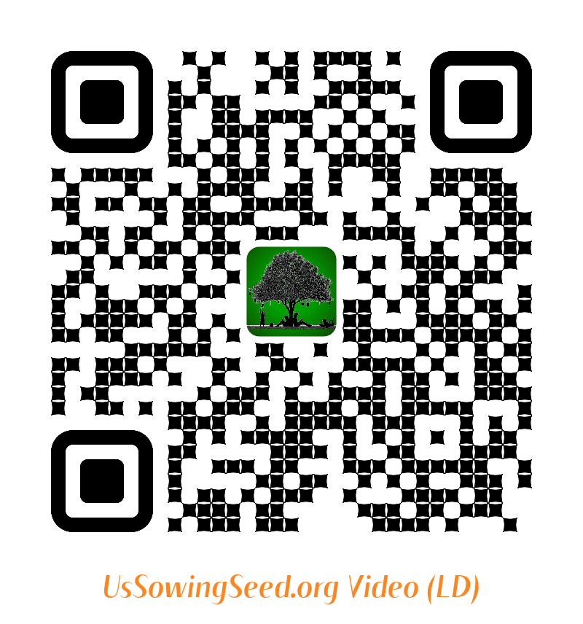
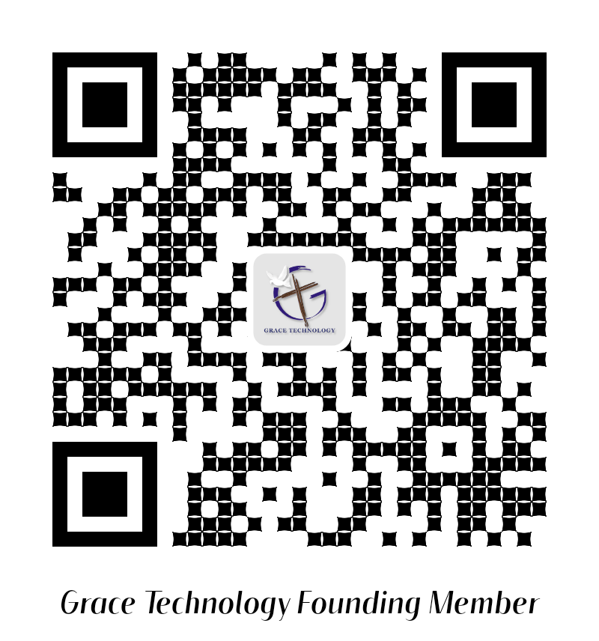
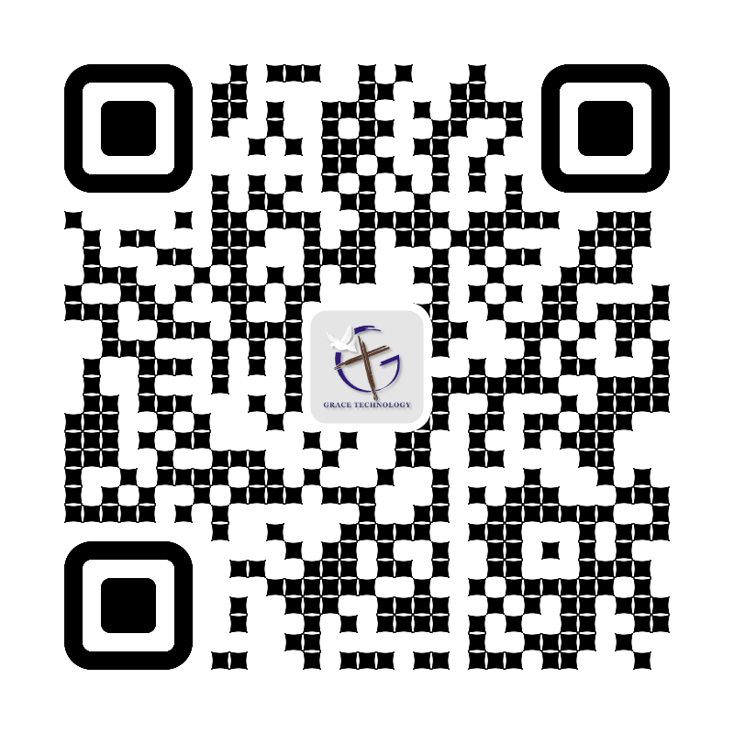
5. “My Jerusalem Street by Street Community Ministry & Outreach” - Outside the Church Walls App ©
Use the following QR codes to view the Bible Video, or to Donate.
Video
Video
Become a Cloud4Christ Founder,
and be one of a 1000 $10.00/Month
Contributors.
Donate
General
Use the above QR codes to “Donate to the Non-profit Grace Technology Organization, as a tax-deductible contribution. Note: you may use a Debit Card, Credit Card, Pay Pal, etc.
14

Slide 15
American Bible Society - Request for Bibles 8-15-24
Here is what American Bible Society (ABS) needs:
Church name
Church address
Contact Name
Contact email
Contact Phone
Number of Bibles and type desired (include ISBN if possible)
Each Church or Christian Organization may submit an E-mail to mbrock@americanbible.org at ABS for free or low-cost Bibles. Check one box as appropriate:
O Request Free Bibles
O Request Low-cost Bibles
Bibles will be distributed to support “Winona’s Children’s Picture Bible Legacy” documented on ABS’s Web, with the Title: “I can’t Possibly Deliver That Many Bibles”. UsSowingSeed.org App
15

