Slide 1
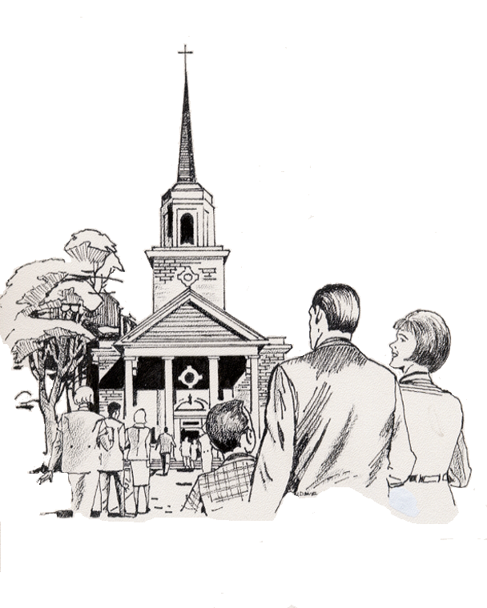

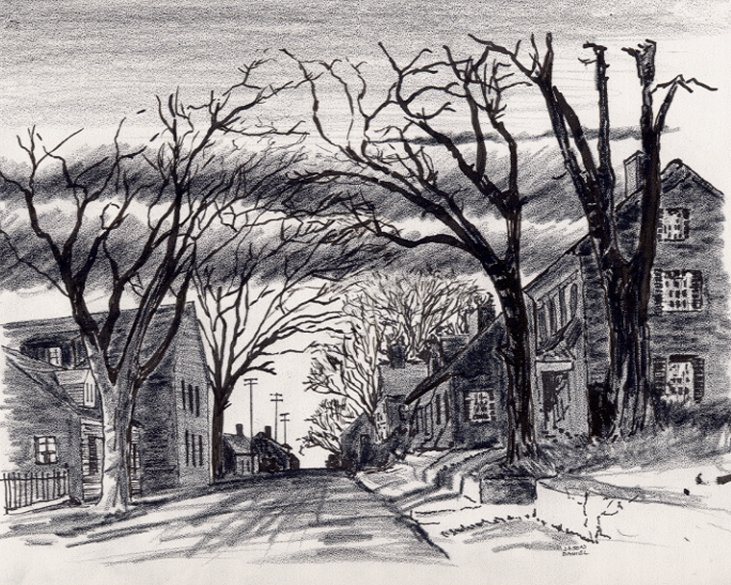
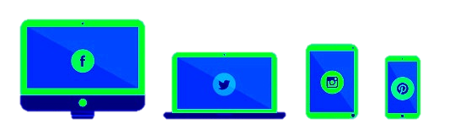

2. “My Street” Residences – Zonderkids Children’s Picture Bible Distribution ©
12-1-20-24
Everyone
Everywhere
Any Device
Any Time
Desktop
Laptop
Notebook
Cell Phone
Dallas CLOUD
National Movement Ministries; Grace Technology Not for Profit; Missions & Small Churches Cloud Management, Finance and IT Infrastructure; UsSowinfgSeed.org and B4EE (Bibles 4 Everyone Everywhere; Cloud4Christ.org Missions & Churches Inside and Outside the Walls Ministries and Outreach, Acts 1-8 Worldwide; Cloud4Christ.org Toolbox Development and Information Technology Support; and World -Wide Support Ministries.
1

Slide 2
2. “My Street” Residences – Zonderkids Children’s Picture Bible Distribution ©
Background:
This Activity, along with our other similar Cloud4Christ.org Cloud World-Wide Web, and Winona’s American Bible Society Bible Legacy have their origins in the fact that Winona, my wife, loved and taught children in public, private and religious organizations for 70 years.
We should not necessarily expect everyone to automatically come to a brick-and-mortar Missions and Churches. Each of us as individuals and members of Christian Organizations should make special efforts to get the Word out.
This capability is also based on the belief that each individual should fulfill Jesus’ command to go into the whole World, meet the World’s needs, encourage all to accept Jesus as their Savior and Lord, and mature in the Faith. Even new Christians should serve in the Church, and of course, follow Jesus’ Command to “Get the word out”.
2

Slide 3
2. “My Street” Residences – Zonderkids Children’s Picture Bible Distribution ©
Purpose:
The purpose of this “My Street” Area Individual, Group and Organization Bible Distribution Capability is to allow mail delivery of a Zonderkidz © Children’s Picture Bible to their self-selected “My Street”, or other definable area, in the U. S. A. It is my prayer that many people will respond spontaneously, and in many ways in a Spirit filled way.
As Bibles are delivered to Street residences, etc, by these activities, many of those receiving a Bible will come to put their faith and trust in Jesus, the true Creator of the universe. This is a proven fact.
You may use our UsSowingSeed.org Web App, or use B4EE.org link along with this How-To Training and Distribution Instruction. This will allow every needed and called person to effectively perform this very needed task, to change our World for God.
3

Slide 4
2. “My Street” Residences – Zonderkids Children’s Picture Bible Distribution ©
Scope
The “My Street” Zonderkidz© Children’s Picture Bible Distribution program includes the following specific Web App functions:
1. Self-Choose your “My Street” (Or an adjacent Street if someone has already adopted your Street).
2. Choose Bibles from our App linked Bible distributors, or others with the best price. Hopefully, your Mission, Church or Grace Technology.org may provide you free Bibles.
3. Purchase the Bibles for personal deliver per UsSowingSeed.org App.
5. Select and record each address where you deliver Bibles. You may use UsSowingSeed.org Web App, or B4EE.org to perform this function.
4

Slide 5
2. “My Street” Residences – Zonderkids Children’s Picture Bible Distribution ©
The Program is important because:
There is not enough time to allow using just old methods and organizations. A new state-of-the-art Cloud Platform with many downloadable Web Apps is now in use. The use of these tools was made possible in early 2024 via www.Cloud4Christ.org Platform. We need to effectively use more laborers, Social Media, and the Cloud4Christ.org ~29 Web Store Apps also.
God has been at work over 2000 Years getting Individuals, Groups and Organizations ready His present End-time push.
God has purposed each of us, and has called and has placed each of us in our roles.
God will be glorified when we use all means to fill his Universal Church, with those believers Jesus has and will grant new life for Eternity.
5

Slide 6
2. “My Street” Residences – Zonderkids Children’s Picture Bible Distribution ©
Four Universal Elements for Churches/Missions:
1. Extraordinary Prayer (Request people to pray with you.)
2. Abundant Evangelism such as “Choose Your One”
Authority of God’s Word
Identify, Disciple and Train all Mission and Church Members
6

Slide 7
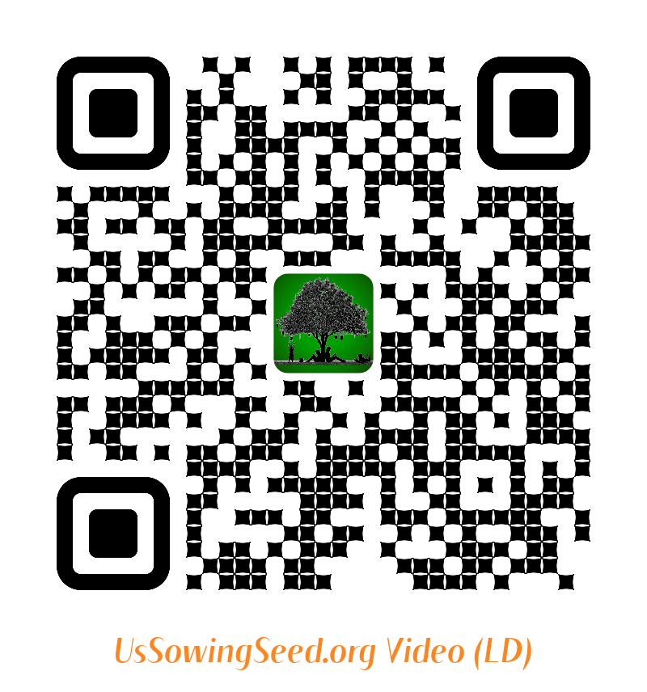
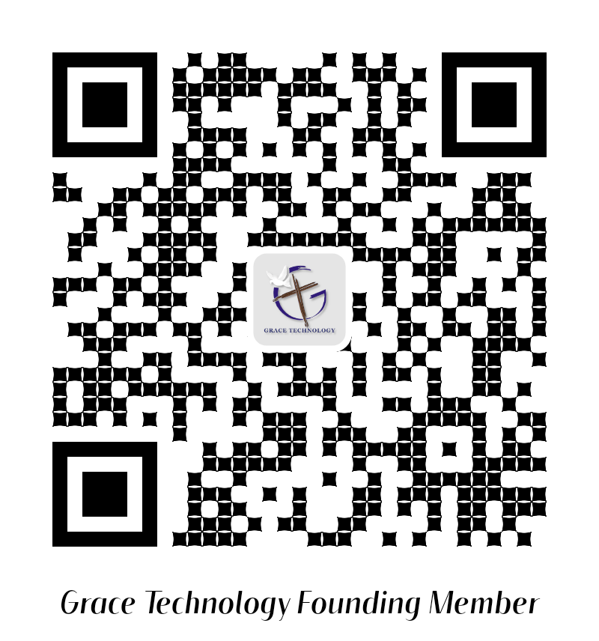
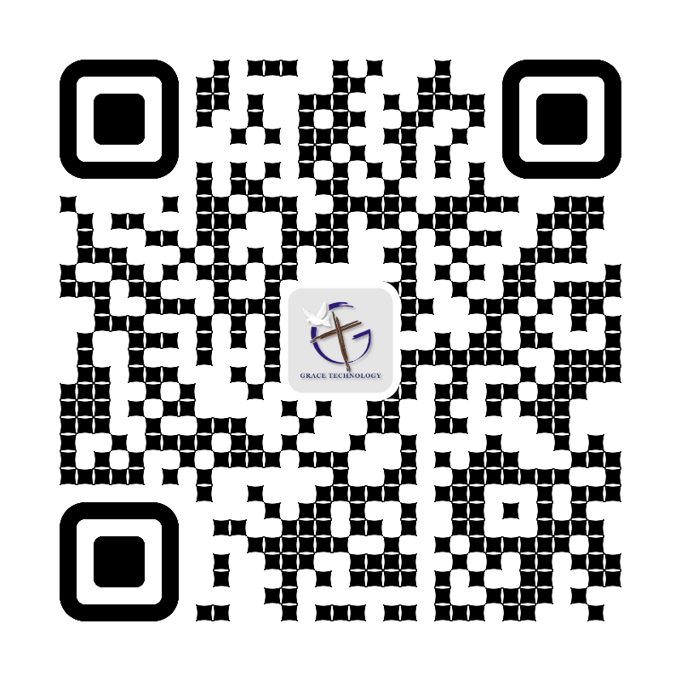
2. “My Street” Residences – Zonderkids Children’s Picture Bible Distribution ©
Use the following QR codes to view the Bible Video, or to Donate.
Video
Video
Become a Cloud4Christ Founder,
and be one of a 1000 $10.00/Month
Contributors.
Donate
General
Use the above QR codes to “Donate to the Non-profit Grace Technology Organization, as a tax-deductible contribution. Note: you may use a Debit Card, Credit Card, Pay Pal, etc.
7.

