Slide 1
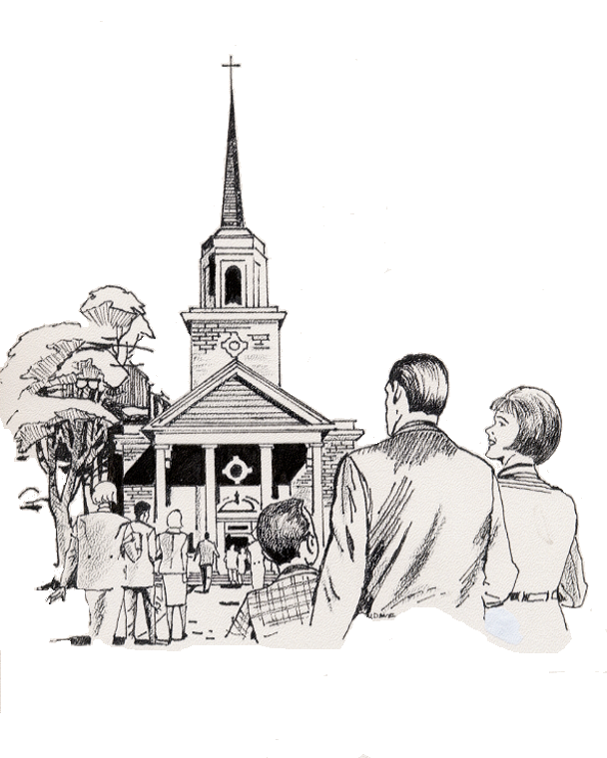

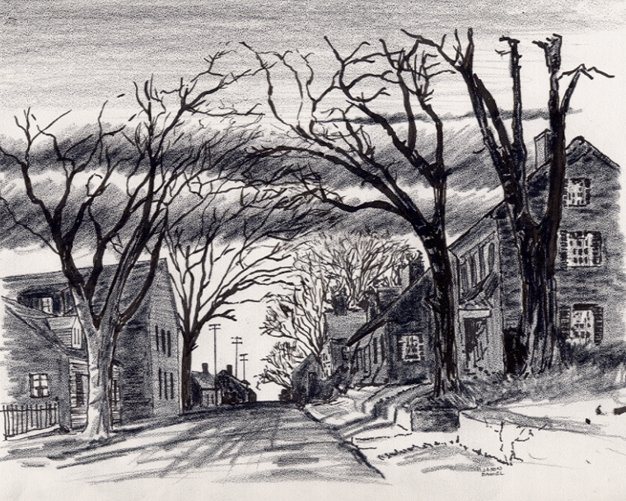


19. Storefront Zonderkidz Picture Bible Distribution App ©
12-1-202424
Everyone
Everywhere
Any Device
Any Time
Desktop
Laptop
Notebook
Cell Phone
Dallas CLOUD
National Movement Ministries; Grace Technology Not for Profit; Missions & Small Churches Cloud Management, Finance and IT Infrastructure; UsSowinfgSeed.org and B4EE (Bibles 4 Everyone Everywhere; Cloud4Christ.org Missions & Churches Inside and Outside the Walls Ministries and Outreach, Acts 1-8 Worldwide; Cloud4Christ.org Toolbox Development and Information Technology Support; and World -Wide Support Ministries.
1

Slide 2
19. Storefront Zonderkidz Picture Bible Distribution App ©
Background:
This project, along with our other similar Church Bible Legacy Cloud Web Projects and Apps have their origins in the fact that Winona, my wife, loved and taught children in public, private and religious organizations for 70 years.
Winona and her husband always had an overwhelming desire to get the word out, particularly to children.
We should not necessarily expect everyone to automatically come to a brick-and-mortar Church. Therefore, we can use this Storefront Web App to help get the Word out.
This program is also based on the belief that each Church Member should fulfill Jesus’ command that they should go into the whole World, meet the World’s needs, encourage all to accept Jesus as their Savior and Lord, and mature in the Faith. New Christians should also serve in the Church, and of course, follow Jesus’ Command to “Get the word out”.
2

Slide 3
19. Storefront Zonderkidz Picture Bible Distribution App ©
Purpose:
The purpose of this App is to allow any Christian organization to establish a Storefront Project, assign an App Administrator, contact local stores to display and provide free Bibles to patrons via this “19. Storefront Zonderkidz Childrens Picture Bible Distribution App ©”
As Bibles are given away by these activities, many of those receiving a Bible will come to put their faith and trust in Jesus, the true Creator of the universe. This is a proven fact.
You may use our UsSowingSeed.org Web App with this How-To Training and distribution Instruction. This will allow every needed and called Individual to effectively perform this very needed task, to change our World for God.
3

Slide 4
19. Storefront Zonderkidz Picture Bible Distribution App ©
Scope
This “19. Storefront Zonderkidz Picture Bible Distribution App ©” allows the selection and recruiting of as many store-front businesses, in reasonable reach of your Mission, Church or Christian Organization.
4

Slide 5
19. Storefront Zonderkidz Picture Bible Distribution App ©
Procedure
This “19. Storefront Zonderkidz Picture Bible Distribution App ©” Project includes the following specific Web App functions:
1. Choose a Project administrator.
2. Establish a store-room for Bibles and use UsSowingSeed.org Web App to obtain Bibles at lowest cost.
3. Contact Store-front representatives and set up store displays.
4. Periodically provide Free Bibles to the store manager.
5. Provide blank Address Record Sheets to the store manager to record Bible residences the Bibles were distributed to.
6. Train a store representative to record each Bible delivery in the UsSowingSeed.org Web App, or periodically pick up sheets and enter the records.
5

Slide 6
19. Storefront Zonderkidz Picture Bible Distribution App ©
The Program is important because:
There is not enough time to allow using just old methods and organizations. A new state-of-the-art Cloud Platform with many downloadable Web Apps is now in use. The use of these tools was begun in early 2024 via www.Cloud4Christ.org Platform. We need to effectively use more laborers, Social Media, and the Cloud4Christ.org ~29 Web Store Apps also.
2. God has been at work over 2000 Years getting Individuals, Groups and Organizations for our just happened November 5, 2024 End-time push. I believe the older generation will provide required guidance, but I believe the Youth; College and University Students, and the Younger Adults must also do the heavy lifting.
3. God has purposed each of us; and has called and has placed each of us in our roles.
This new technology is available now to instantaneously allow immediate and complete integration and proof of Great Commission completion. Log onto UsSowingSeed.org Web App and register to perform your work on the App.
God will be glorified when we use all means to fill his Universal Church, with those believers Jesus has and will grant new life for Eternity.
6

Slide 7
19. Storefront Zonderkidz Picture Bible Distribution App ©
Open 18. USS Addresses, Bible Types, etc. Sheet.xlsxThe Program and make needed copies of the two sided address sheet.
7

Slide 8
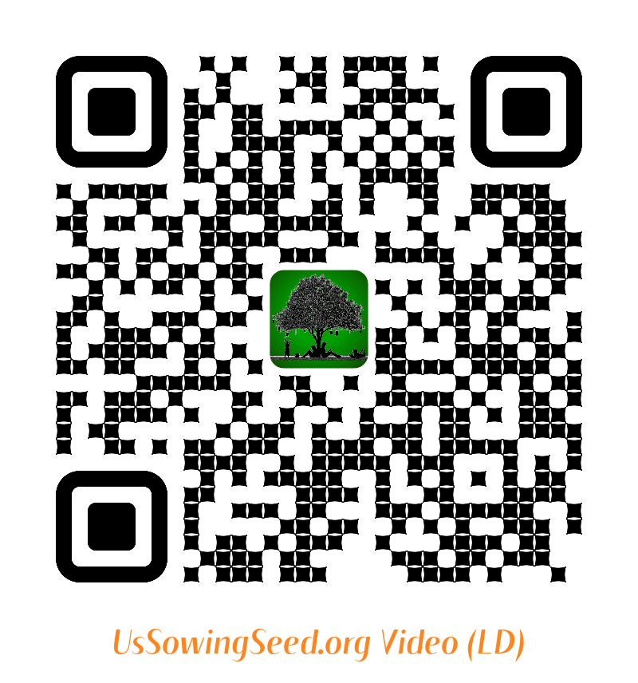
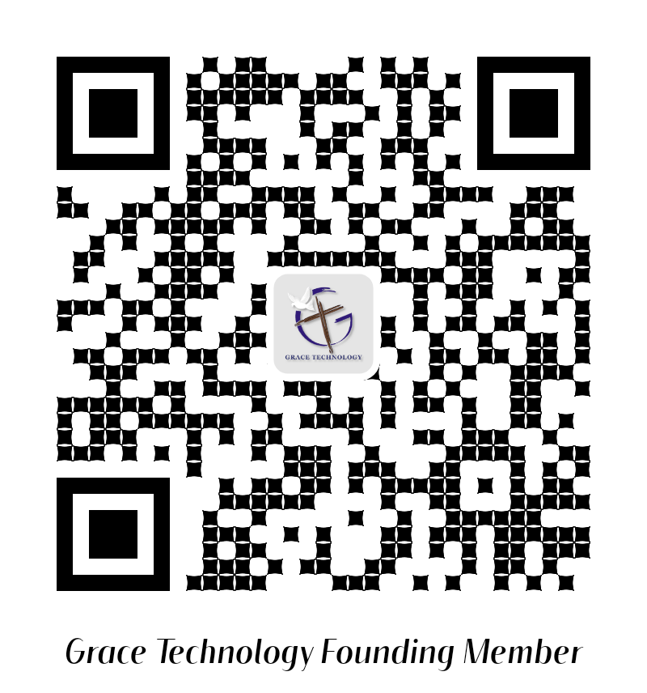
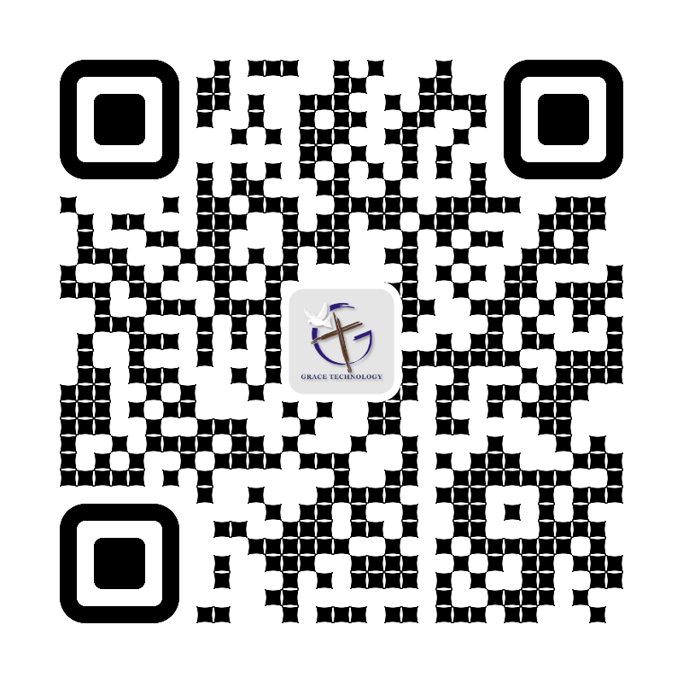
19. Storefront Zonderkidz Picture Bible Distribution App ©
Use the following QR codes to view the Bible Video, or to Donate.
Video
Video
Become a Cloud4Christ Founder,
and be one of a 1000 $10.00/Month
Contributors.
Donate
General
Use the above QR codes to “Donate to the Non-profit Grace Technology Organization, as a tax-deductible contribution. Note: you may use a Debit Card, Credit Card, Pay Pal, etc.
8.

