Slide 1


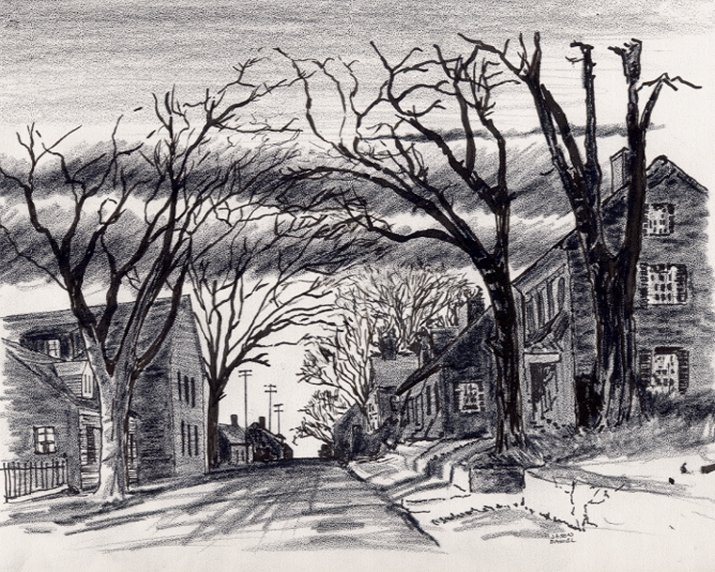

14. Winona’s Bible Distribution Legacy.ppt ©
Everyone
Everyplace
Everywhere
Any Device
Cell Phone
Notebook
Laptop
Desktop
Dallas CLOUD
4-28--2024
Cloud4Christ Church Inside and Outside the Walls Ministries; National Movement Ministries; World -Wide Support Ministries; Cloud4Christ.org Tools Development and Information Technology Support; Missions & Small Church Cloud Management and IT Infrastructure; and Bee Ministries
Page 1

Slide 2

Winona’s Bible Distribution Legacy Story ©
Page 2

Slide 3
Winona’s Free Bible Distribution Legacy “ Founder Member Club” Fund Raiser” ©
The previous page article of Winona’s Legacy was prepared as a joint effort between American Bible Society (ABS) and I as a North American Mission Board Companion, Church Mission Service Corp. Missionary.
The Newsletter was distributed in the April 2024, Monthly “Good Newsletter” to approximately 265,000 subscribers after an interview with me and my approval.
The intent of the fund raiser, after 10 years of self-funding by three lay people, is to, as quickly as possible, fulfill Winona’s vision.
Our Vision and Goal has been for many years to orchestrate the delivery of at least one verifiable Free Children’s Picture Bible to each of 131,000,000 U.S.A. residences in 3 Years.
Note: A second Goal is to help many receive the World simultaneously.
Page 3

Slide 4
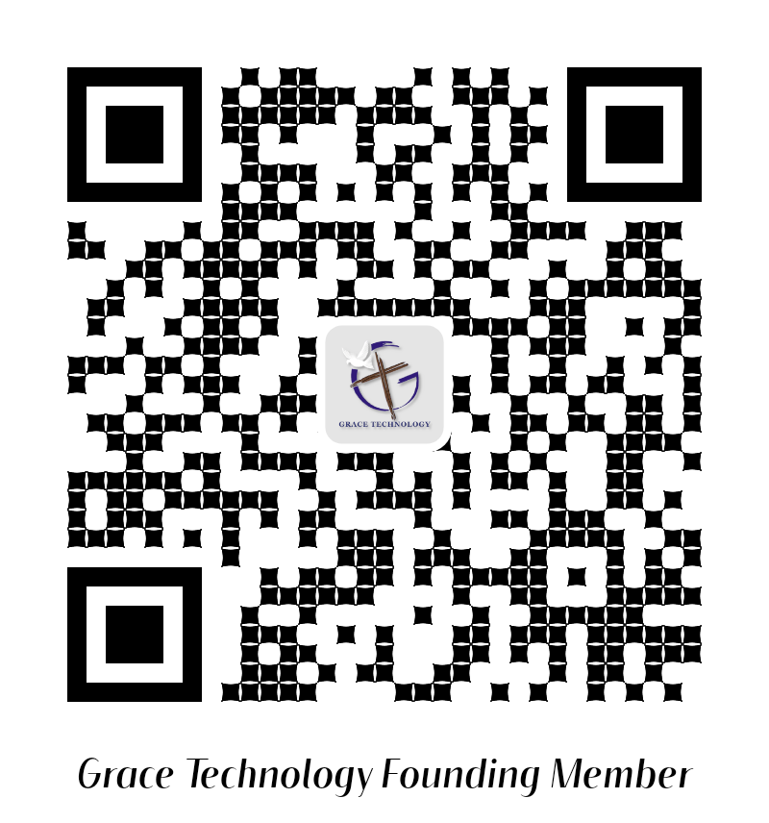
https://giving.classy.org/campaign/571654/donate
Page 4

